Slide 1

FIFA PLAYERS STATISTICAL DETAILS
BY RISHIKA BHUNIA

Slide 2


CONTENT :
BACKGROUND
ABOUT
TOP PLAYER RANKING
AGE ANALYSIS
MARKET VALUE ANALYSIS
WAGE ANALYSIS
COUNTRY WISE PLAYER ANALYSIS
TOP 5 CLUB

Slide 3

BACKGROUND :
This capstone project is based on the attendance, matches and goals data collected across 20 World Cups. The FIFA (Federation Internationale de Football Association) World Cup is the biggest football and arguably the greatest sport tournament in the World, It is played every four years between the Men’s national football team who are accredited members of FIFA and it has been in existence since 1930 up till date. The inaugural World Cup was hosted in Uruguay and it consisted of thirteen Countries; seven from South America (host), two from North America and four from Europe. The most recent World Cup which was in 2018 according to our case study data.

Slide 4

ABOUT:
This Dataset consists of the players data for FIFA game till 2018.
The table consists the following columns :Name, Age ,Nationality, Overall rating, Potential rating, Club Value, Wage, Preferred Foot, Jersey No, Joined, Height, Weight, Penalties

Slide 5
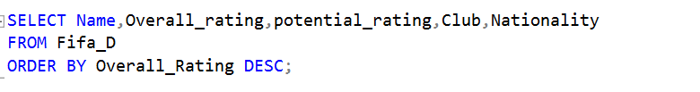
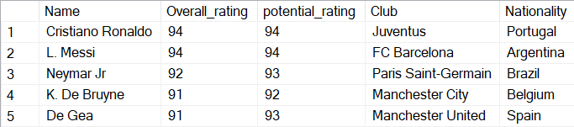
TOP 5 RANKING PLAYERS BASED ON THE DATASET
Both Ronaldo and Messi reign supreme with the leading Overall Rating.

Slide 6
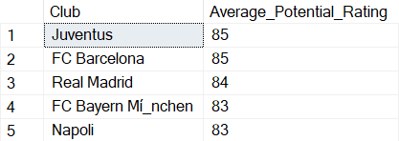
TOP 5 CLUB
SELECT TOP 5 Club, AVG(Potential rating) AS Average_Potential_Rating
FROM Fifa_D
GROUP BY Club
ORDER BY Average_Potential_Rating DESC;

Slide 7
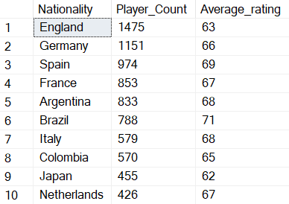
COUNTRY WISE PLAYER ANALYSIS
SELECT TOP 10 Nationality, COUNT(Name) AS Player_Count,AVG(Overall_rating) AS Average_rating
FROM Fifa_D
GROUP BY Nationality ORDER BY Player_Count DESC;
England contributes a significant number of players to the global footballing landscape.

Slide 8
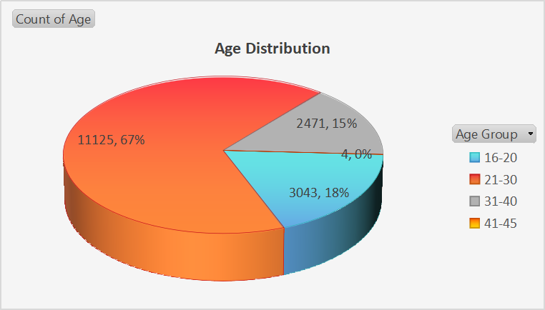

AGE ANALYSIS :
O. Pérez of Mexico was the oldest
player in given dataset with a age of 45 years.

Slide 9

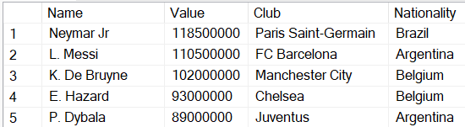
MARKET VALUE ANALYSIS :
Among all players, Neymar holds the distinction of having the highest market value.

Slide 10
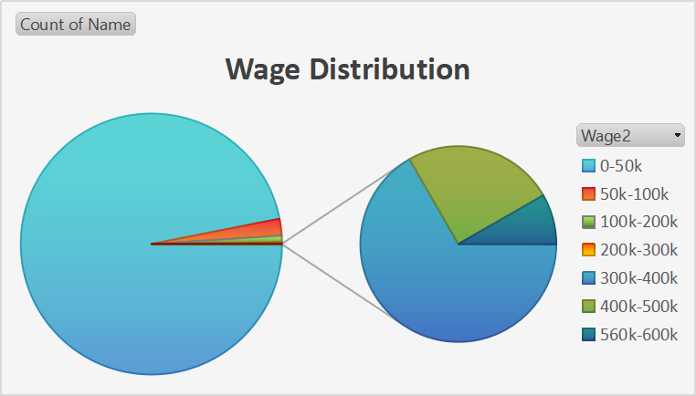

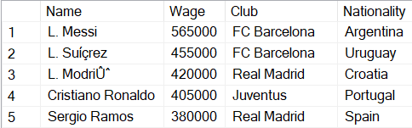
WAGE ANALYSIS :

